Slide 1


‘Flipping the classroom’
www.englishteacher.co.nz
By Yvonne Hynson (Unitec)
Crown Workshops Jul 16
Notes:
The NING, JING and MOODLE song lyrics by Yvonne Hynson- JING is the name of a screencast software, NING is a social networking site and MOODLE is the platform currently replacing Blackboard at our institution.
CHORUS
A NING a JING a NING
And a MOODLE course or two
They are at our university
OH A NING a JING a NING
And a MOODLE course or two
They are made by me and you
Verse 1
A NING’s for him and her and them and us and me and you
And they’re conversations tooo
A NING’s for him and her and them and us and me and you
And they’re made by me and you
Verse 2
A JINGs a ‘how to’ video of our computer screens
And it tells the students what to do
They watch them many times till they know just how to do things
On the moodle course made by me and you
Verse 3
The MOODLE ’s got oodles of things to do in every course you see
And it’s JINGs and conversations too
The MOODLE ’s got oodles of things to do in every course you see
And they’re made by me and you

Slide 2

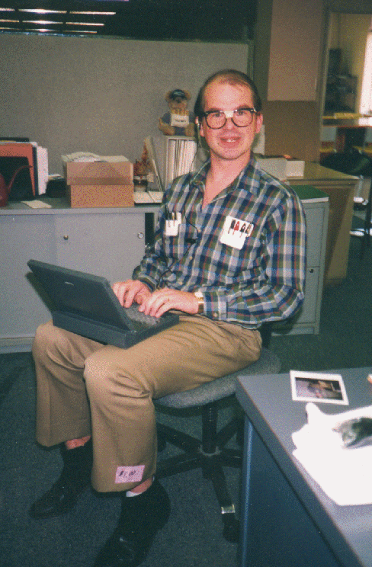


Notes:
What ‘flipping the classroom’ doesn’t mean:
Students working in isolation
Only on line videos
Replacement of teachers with videos
Students spending the entire class staring at computer screens
An online course
Students working without structure
X

Slide 3
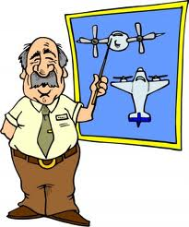

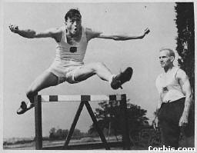
X
Notes:
What ‘flipping the classroom’ means continued
The teacher is the ‘guide on the side’ not the ‘sage on the stage’
This is scary because the teacher’s tradtional role is under threat and some find the adjustment difficult.
Content is permanently archived
However it could be links to content – ON YOUTUBE OR a folder in your screencast library
Students who are absent don’t get left behind
A personalised education for all

Slide 4


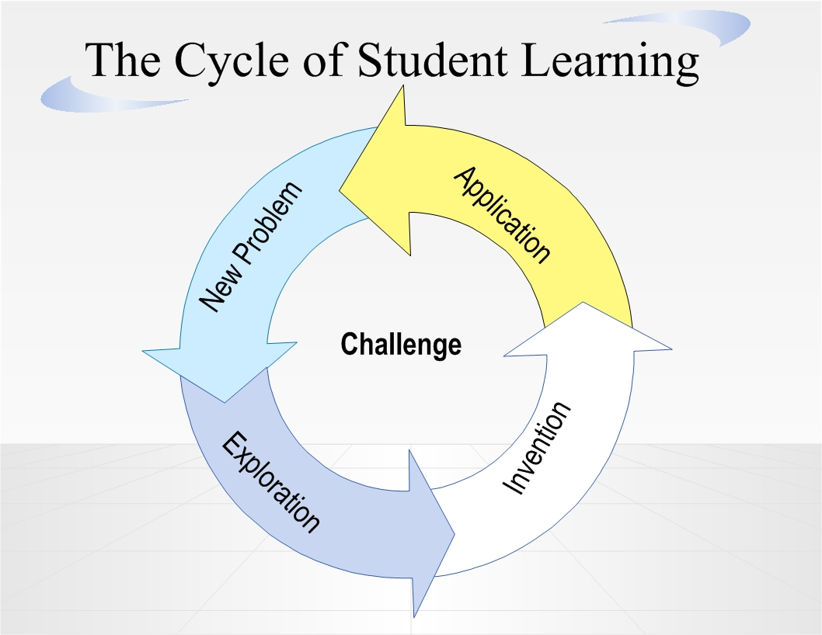
Notes:
What it also means:
Students become more engaged in their learning
Students taking responsibility for their own learning
This is from the webpage below and looks at math content:
instead of lecturing about polynomials and exponents during class time – and then giving his young charges 30 problems to work on at home – Fisch has flipped the sequence. He’s recorded his lectures on video and uploaded them to YouTube for his 28 students to watch at home. Then, in class, he works with students as they solve problems and experiment with the concepts. Lectures at night, “homework” during the day. Call it the Fisch Flip.
“When you do a standard lecture in class, and then the students go home to do the problems, some of them are lost. They spend a whole lot of time being frustrated and, even worse, doing it wrong,” Fisch told me.
“The idea behind the videos was to flip it. The students can watch it outside of class, pause it, replay it, view it several times, even mute me if they want,” says Fisch, who emphasises that he didn’t come up with the idea, nor is he the only teacher in the country giving it a try. “That allows us to work on what we used to do as homework when I’m they’re to help students and they’re there to help each other.”
When he puts it like that, you want to slap your forehead at the idea’s inexorable logic. You wonder why more schools aren’t doing it this way.
http://www.connectedprincipals.com/archives/1534
Jon Bergman and Aaron Sams, in Colorado, have worked hard to develop many of these techniques; the following is a set of their resources on-line.
Our Webpage: http://educationalvodcasting.com/
Our NING: http://vodcasting.ning.com/
Article About us: http://thejournal.com/Articles/2009/08/09/Vodcasting.aspx?Page=1
Video about us (news station): http://video.google.com/videoplay?docid=-1962958416930816240&ei=27elSrfHIILIqQLq_N3uBA&q=woodland+park+podcasting#
Self Made Video for our Students:http://chempodcasts.mindbites.com/lesson/5093-chemistry-1-a-introduction-to-chemistry

Slide 5

Notes:
A blending of direct instruction with constructivist learning
increased interaction and personalized contact time between students and teachers
Is it getting rid of teachers? N
Does the teacher’s role change? Y
Is this scary for some teachers? Y
Do students get to learn at their own pace more? Y
Is it changing the dynamic of the classroom? Y
Is it only looking at videos?N
Should this approach increase contact between teachers and students in meaningful ways?Y
Do students work without structure?N
Do students spend the whole time looking at computer screens?N
Don’t move onto slide 6 but ask them to talk about feedback on writing.

Slide 6
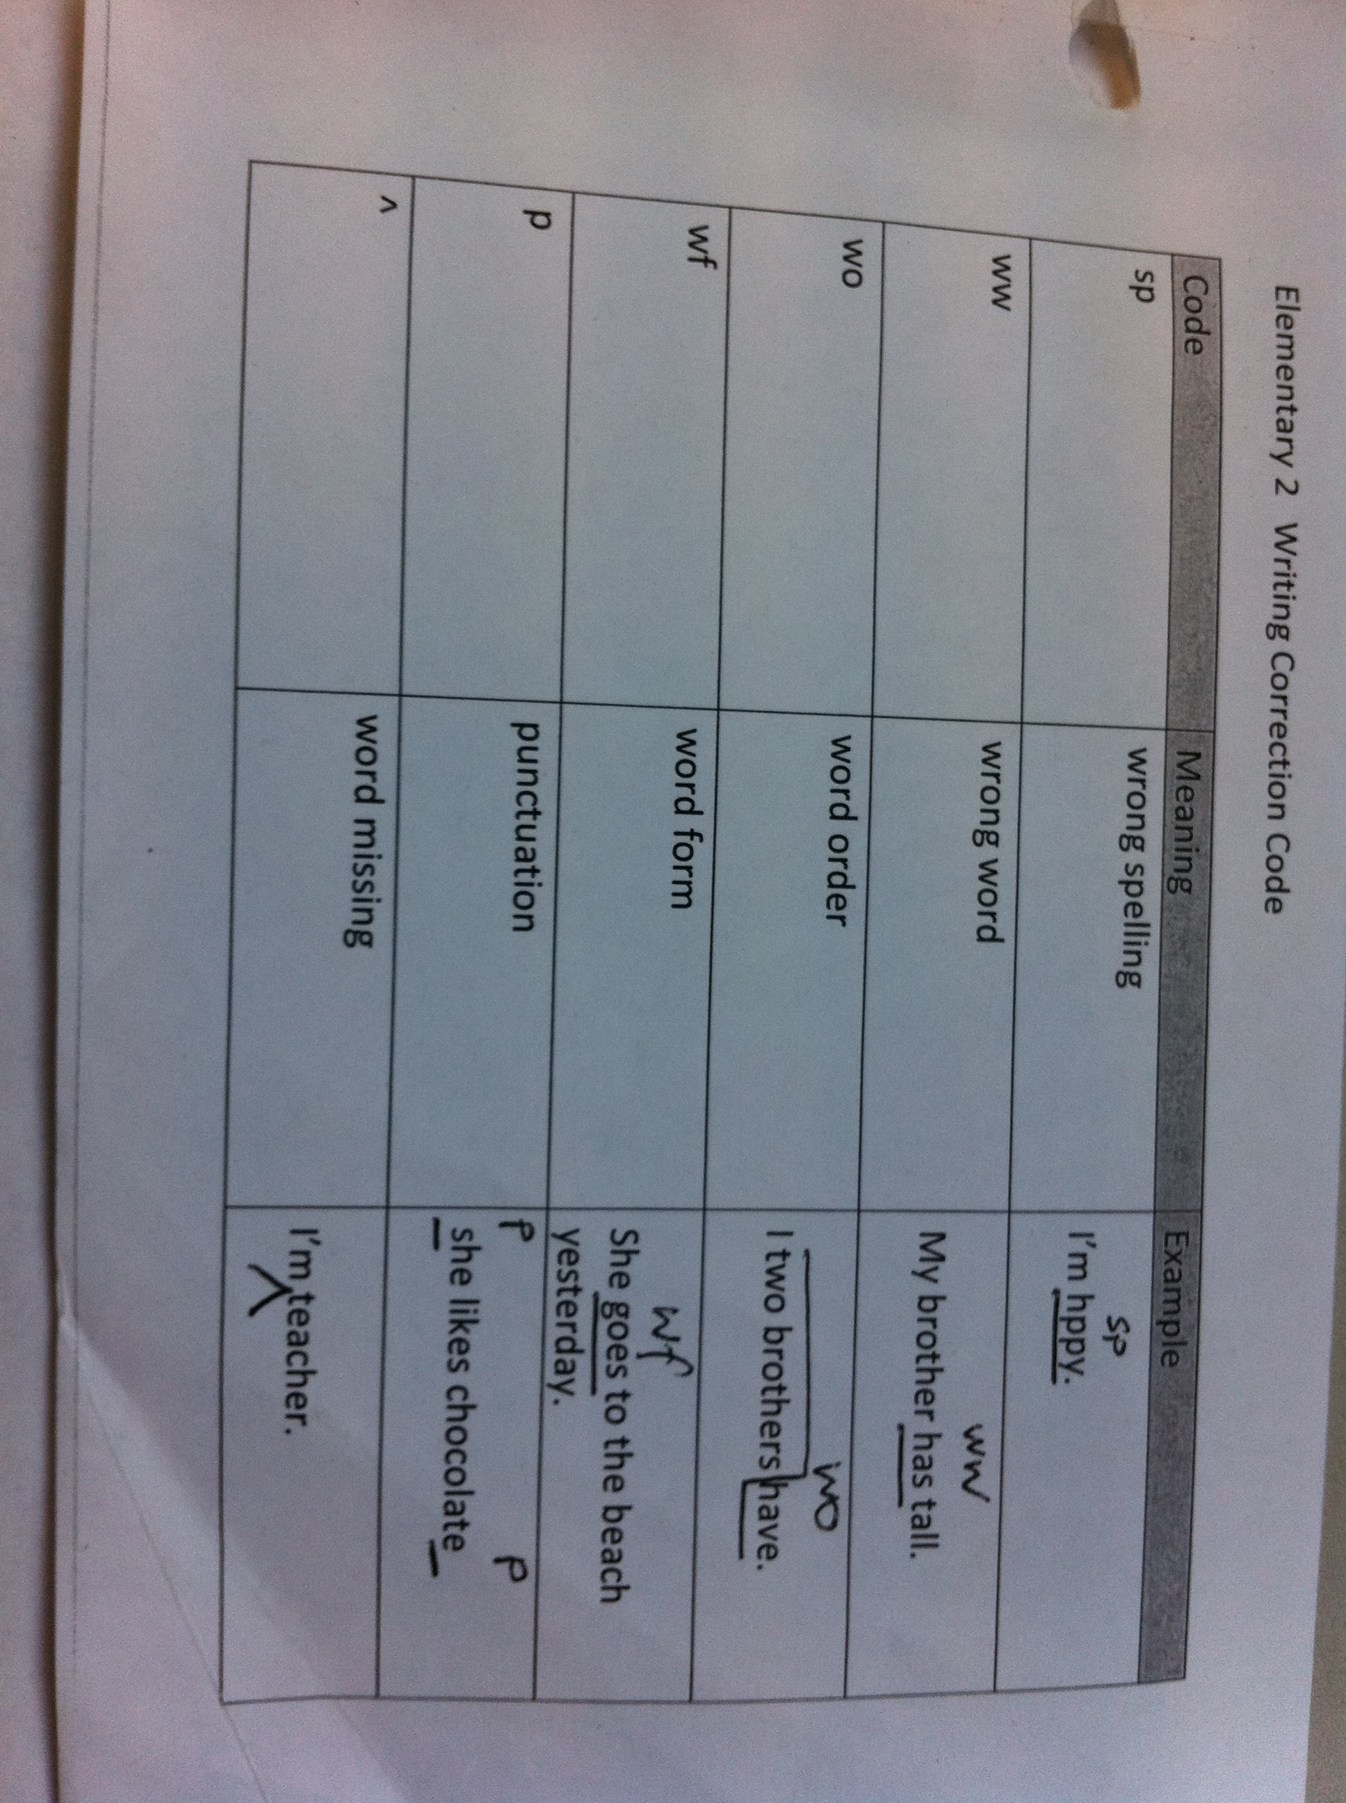
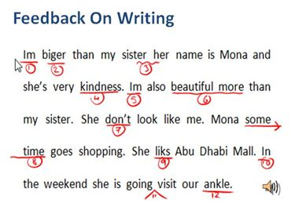
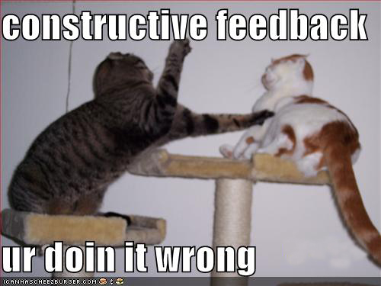

Notes:
One example of ‘flipping’ is giving screencasts for writing feedback or making students create the screencasts.
How do you give writing feedback?
(Quick chat with neighbour then feedback on this.)
Traditional feedback methods
One to one –personalised and nearly always the best way but time consuming
Writing codes- deeper processing but students need to learn codes and their writing is written all over by you. Screencasts mean they have the same piece of writing back and correct it after watching your feedback JING.
Competitively editing- take one sentence from each writing for correction and students work in groups to make it better.
Peer editing-pairs or small group editing – I have found this only semi-successful and really depends on the dynamics of the class.

Slide 7




Notes:
Examples of CALL methods
Email you their writing
Email- do you print out and code it or spend time correcting and send it back?
Email with an attachment- WORD
http://www.jiscdigitalmedia.ac.uk/audio/advice/audio-feedback-a-how-to-guide
RHS picture is a screenshot of the site
WORD audio feedback - Have never used this but it is one of the ways that has been successful. Has anyone? Drawbacks?
Tape cassette for students to replay again and again or Audacity file- these are ‘flipping’ examples
SKYPE and ichat are two way but there is a ‘delay’ factor still which makes the conversation stilted and not very natural. You need the students work up on the screen and using audio is good but you also have to be present and once again there is only one chance for the student to understand unless it is recorded in some way.
How many of the methods were mentioned by workshop participants? Were there any others?

Slide 8
Example 1: an email from a student. Writing focus is an invitation to a party. This is using JING.
http://www.screencast.com/t/JPMyK9ludgk
Notes:
This is one feedback done early on and exemplifies the need for quiet in your recording area – wind chimes in the background – don’t eat just before you record and don’t rush through it or swing the mouse wildly.

Slide 9
Notes:
Using screencasts is engaging and personalised.
Another advantage of screencasts:
Use screencasts (JINGs) more for peer and individuals to learn from
The top picture shows the folder so the student can access all the other students feedback, listen and learn from peers’ feedback too.
Sharing of background knowledge too.
Introduction to screencast.com (makers of Camtasia)
www.screencast.com (JING)
Sizing is easier
Folder for peer appraisal
Can make it private
BUT hissing ‘s’ and limit of 3-4 mins.
Steps to using a screencast for feedback:
Go to Jing and download free software – for the Jul 16 Crown workshop this has been done for you
Register for free with email, PW if you want to have a library – in the Crown workshop there will not be time for this
CROWN WORKSHOP INSTRUCTIONS:
Hold your mouse over the ‘sun’ icon and you will see 3 paths: making a JING (cross hairs), history and tools.
Open file for feedback or go to Internet and find a picture of text to practice with
Mumble what you are going to say -even make notes if necessary
Make sure you open the toolbox if you are going to show them how to do something with WORD
Look for the ‘sun’ app icon (again) and touch it to show 3 paths: making a JING (cross hairs), history and tools.
Touch the cross hairs and pull the intersection DOWN and to the right to capture the size of your video
You will see 5 icons inside a yellow oblong circle. The first is just a still image. To make a video click the ‘film’ icon
You now have 321 come up on the screen so breathe deeply then talk using your mouse to illustrate something on your screen.
Press STOP on the left NOT x on the right as this cancels it.
If you have registered then you have a library. Upload to your library. (JING)
Move it to a folder to make it private.
Open the screencast and grab the link
Email the student with the link

Slide 10
Steps to using JING screencast for feedback
Hold your mouse over the ‘sun’ icon and you will see 3 paths: making a JING (cross hairs), history and tools.
Open file for feedback or go to Internet and find a picture of text to practice with
Mumble what you are going to say -even make notes if necessary
(Make sure you open the toolbox if you are going to show them how to do something with WORD)
Look for the ‘sun’ app icon (again) and touch the cross hairs and pull the intersection DOWN and to the right to capture the size of your video and click for stop
You will see 5 icons inside a yellow oblong circle. The first is just a still image. To make a video click the second ‘film’ icon
You now have 3 secs: 3-2-1 come up on the screen so breathe deeply then talk using your mouse to illustrate something on your screen.
Press STOP the box on the left (NOT x on the right as this cancels it). You will now see a preview and a dialog box for a name. Check it. It is now in your history where you can decide what to do with it. If you want to grab the link then you need to register with your email and press the multiarrow.
Notes:
Once you are happy and have labeled it, the JINGis In History
The eye on the left is view
To grab the link you will need to touch the multiarrow icon (and register.) or you can just open it and copy the url.
If you register, watch all the screencasts on the site to make your library and moving screencasts from JING (public) to a folder (Private)
Now you are the autonomous learner!

Slide 11
http://www.screencast-o-matic.com/watch/cXhlcdbET
http://www.screencast-o-matic.com/watch/cXhlVnbEw
http://www.screencast.com/users/Yvonnz/folders/Elementary 2 writing feedback - May2011/media/53ef208a-7251-4b27-8fa3-0e1dfe1be905
Example 3: feedback on a student’s screencast
Notes:
If I have time in the Crown workshop I will show these however if you are interested you can go and look yourself. Screencast-0-matic.com has a longer time frame but less privacy. You have 3 options for saving though and one of these is direct to Youtube.
The last link was a JING feedback on a student’s first screencast to see if it worked. The 60+ year old student used the word ‘cathedral’ correctly to me on a field trip held 2 weeks later so pronunciation feedback was successful as far as I was concerned.
Attendees should now spend the rest of the session trying out both sites if possible.
Screencast-o-matic only has a privacy function for premium ($$$you pay).
Skip to the last slide for PP link.
(There is probably not enough time for the rest of this presentation – slides 11-14. Download the powerpoint from my site-see slide 1 or the last one.
Other ways to ‘flip the classroom’, useful CoPs to join and the issue most teachers ask about: how much time does is take?)
www.screencast-o-matic.com
FREE. Longer time so good for long texts and students to use immediately or they can register.
Upload to youtube but not sure if it is private
Reasonable upgrades for both sites mentioned.
Examples of students making screencasts:
http://www.screencast-o-matic.com/watch/cXhlcdbET
http://www.screencast-o-matic.com/watch/cXhlVnbEw
Feedback to a student on their first screencast. The student is over 60 years.
http://www.screencast.com/users/Yvonnz/folders/Elementary%202%20writing%20feedback%20-%20May2011/media/53ef208a-7251-4b27-8fa3-0e1dfe1be905
Camtasia software?? Is also made by Techsmith. Similar to a professional recording studio and not as easy to get around but professional results. Used by the librarians at Unitec and one or two savvy colleagues.

Slide 12
Examples of students making screencasts:
http://www.screencast-o-matic.com/watch/cXhlcdbET
http://www.screencast-o-matic.com/watch/cXhlVnbEw
http://www.screencast.com/users/Yvonnz/folders/Elementary%202%20writing%20feedback%20-%20May2011/media/53ef208a-7251-4b27-8fa3-0e1dfe1be905
Notes:
Students can make one without any saving except the link at screencast-o-matic but java script appelet dialog box comes up and you click yes.
If they register for free, then they can talk for much longer – 10mins, no hissing s and they can save to three different places SOM is the equiivalent of library on the other site but you cannot make it private without paying, or youtube directly.
These are Elementary students and this was their first attempt.

Slide 13

Notes:
Why change my writing feedback?
Feedback from a colleague at Unitec: Kath Danaher is on the Diploma Text option.
I have been using screencast-o-matic.com to mark EAP essays. I went away from Jing, because it only gave me a 5 minute recording time, which wasn't enough for a sizeable essay. Screencast-o-matic gives you 15 minutes, I think. Anyway, at first it was quite a lot slower, as you would expect, but I did get faster. I found I did need to print out the essay first and think about what I was going to say, and I also found that I missed a few things in the recording, whereas on paper of course you can go back and do it easily. The feedback from the Ss was that they found it an extremely useful method of feedback. One of them couldn't access the recording from home - possibly a Java problem, and so had to listen here at Unitec. I think it's mainly useful when you have to make extensive comments on structure, which would take a long time to write down, but are pretty easy to say. I generally made about a 10-11 min recording for each essay (my class have big problems with essays).
http://community.learningobjects.com/Users/Nancy.Rubin/Objects_of_Interest/2011/01/Audio_Feedback_for_Students
Lots of research confirms success stories with audio feedback and local anecdotal evidence supports use of screencasts as well.
SCREENCAST FEEDBACK engages VAK learning styles altogether.
ISSUES??
What about the workload? I have found you get quicker and overall it is a much more personalised approach to feedback. Students have accessed their own videos up to 6 times or more so it shows that they are learning at their own pace as well.
Providing feedback for students is one of the most important (and often most difficult) part of being a teacher. Providing feedback to students in audio format has been the topic of many recent studies. In a study done by the Sloan Consortium, audio feedback was received very positively by students.
Audio feedback was perceived to be more effective than text-based feedback for conveying nuance;
Audio feedback was associated with feelings of increased involvement and enhanced learning community interactions;
Audio feedback was associated with increased retention of content; and
Audio feedback was associated with the perception that the instructor cared more about the student.
Document analysis revealed that students were three times more likely to apply content for which audio commenting was provided in class projects than was the case for content for which text based commenting was provided. Audio commenting was also found to significantly increase the level at which students applied such content.
JISC (digital Media – free help and advice to the UK further and higher ed comm) has done quite a bit of research on the topic of audio feedback. According to the National Student Survey (HEFCE, 2007) student feedback from tutors and assessors impacts heavily on student satisfaction. Themes that emerged in case studies, that help define this improvement include:
Communicating on a more personal level
The ability to present tone
Motivating students
Informing students how to improve
Forcing students to listen to all of the feedback, not selecting only the sections they desire
Providing an alternative to often ineligible handwriting

Slide 14
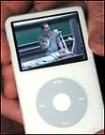


Notes:
Are screencasts as good as vodcasts and podcasts for ‘flipping the classroom’?
All 3 are ways to flip the classroom and can be used for different tasks: feedback or creation of content, content and interactive class practice, and content and pronunciation or speaking activities for use with WMD – not weapons of mass destruction but wireless mobile devices!
How to put your content out there…
Vodcasts – Youtube* or make them yourself and upload (Screencast-o-matic.com is 15 mins total cf 3mins with screencast.com)
*In youtube search type in the structure you want students to learn. I search through them and choose funny ones to show in class but teachers have uploaded pages of presentation examples ….
Try typing present simple tense for example.
http://www.youtube.com/results?search_query=present+simple&aq=f
Suggest ones to look at for them but digital natives will look at others while they are there.
#Podcasts- mean students subscribe to you or sites you recommend
http://www.flickr.com/photos/eltpics/sets/
Free theme photos for your students to add to or use for description rather than ‘googling’
http://community.learningobjects.com/Users/Nancy.Rubin/Objects_of_Interest/2010/04/Podcasting_-_Audio_on_the_Go
What makes a Podcast different?
The fact that they allow you to subscribe to them. New episodes are automatically downloaded as they are produced. Listeners can subscribe via Podcatcher software, and an RSS reader that supports enclosures, or iTunes.
Even though the technology has been around for a while, we are still experimenting with audio.
The idea is not to create a Podcast that sounds something like you would hear on the AM/FM or even Satellite dial. The idea here is to use this opportunity to experiment - with both audio and video. So, instead of always getting a "produced" show, what you're hearing is usually an attempt to do something different.
http://www.twistimage.com/blog/archives/the-purpose-of-podcasting/
#Podcasts in the classroom?
Students can download their podcasts from their classes and view them wherever they go, whenever they like.
New episodes of a podcast are automatically downloaded when students “subscribe” to that particular podcast.
Instructors can limit the audience to students in their course.
Instructors can produce and publish their own podcasts.
What can you do with podcasts?
Digital Storytelling
Student Speeches
Student Plays
Poetry Readings or Poetry Slams
Language Lessons
Class or School Newscast
Oral History Projects
Field Trips
Community History Projects
Class Materials

Slide 15



Other ‘flipping’ sites
Notes:
http://www.spellingcity.com/
Games for vocabulary learning
www.survveymonkey.com
Great for student generated surveys.
http://www.classtools.net/Students generate the games themselves for others in the class to use
Students contribute to the site or use photos to create a conversation (their own screencast around).
http://www.flickr.com/photos/eltpics/sets/
http://prezi.com – students create a presentation in a more dynamic form than Power Point. I am still playing with prezi and did not have enough time or confidence to switch to it but you can import PP directly into it.
CoPs to join:
http://vodcasting.ning.com
Useful information
http://www.cats-pyjamas.net/2011/04/looking-for-interesting-examples-of-blended-learning/
Lots of slide shows to give you ideas on how to present content
Digital camera ideas for the classroom:
http://drscavanaugh.org/digitalcamera/
http://sandymillin.wordpress.com/2011/05/18/how-to-join-in-with-eltpics/
A site with lots of useful ways to use all of those photos and how to encourage your students to join.
Video game models
http://www.fluency21.com/blogpost.cfm?blogID=1985
Stimulating PP from Nancy Rubin about Best Practices for integrating 2.0 into the classroom with website links
http://community.learningobjects.com/Users/Nancy.Rubin/Objects_of_Interest/2011/03/Social_Learning_Best_Practices

Slide 16
You can email me at
yhynson@unitec.ac.nz or
yhynson84@gmail.com
Notes:
The Powerpoint will be on my website:
www.englishteacher.co.nz
Go to archives or maybe there will be a link on the front page….
Thanks and go out and practice now as this is the key to all learning!!
ALSO as I keep reminding teachers at UNITEC – if we expect our students to be autonomous learners then it is about time we started putting it into practice ourselves as we should be the role models.
Ka kite ano

